Slide 1
Syllabus
Definitions, types of mechanism, linkage diagrams, motion transformation, degrees of freedom. Analysis of linkages: relative velocity, method of instantaneous centres, velocity diagrams. Application to four-bar linkages: straight line mechanisms, Ackerman's steering linkage, differential aileron mechanisms, landing gear retraction mechanisms
Method of virtual work: application to aircraft control systems and landing gear retraction. Gears: kinematics of gear trains, applications (i.e., including torque tube control systems). Toggle mechanisms. Principles of landing gear design.
Multiple answers Test
Read the questions – you may be asked to provide proof of the answers
(15 % total mark)
Notes:
AENG11301 - Aeronautics and Mechanics

Slide 2
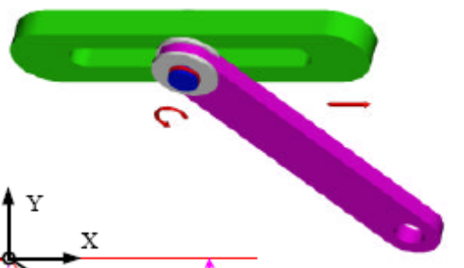
Linkages – things to know
Definitions of linkage, links and joints
How to determine the Degrees of Freedom of a linkage (Gruebler’s formula)
1 DOFs and MDOFs joints
Kinematics and design of a 4-bar linkage
Grashof criteria
Example of Test question
Indicate how many degrees of freedom the pin-in-slot joint possess [5 marks]:
3
2 ½
2
1
2.5
X
5
At least 5 different answers are proposed
Notes:
AENG11301 - Aeronautics and Mechanics

Slide 3
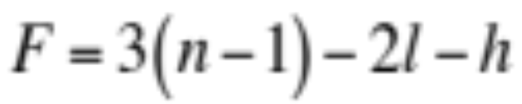
Degrees of freedom in a mechanism
Gruebler’s equation can also be formulated as:
Where:
F= degrees of freedom
n= number of links (including frame)
l= number of lower pairs joints (e.g. 1 DOF –pin joints, for example)
h= number of higher pair joints (e.g. 2 DOFs)
P
Example:
n = 3 (links AB, BC and frame AC)
A
C
l = 2 (pins A and B)
h = 1 (roller C)
B
F = 3 X (3-1) -2 X 2 – 1 = 1
Notes:
AENG11301 - Aeronautics and Mechanics

Slide 4
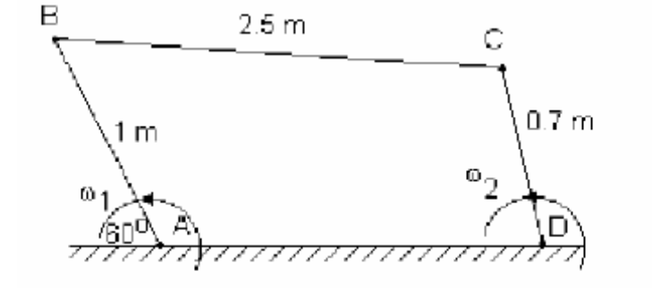
Velocity diagrams
Example: 4 bar linkage
ω₁ = 500 rpm
? ω₂
Ans.
ω₁ = 500 rpm = 2 X π X 500/60 = 52. 36 rad/s
(v_{B})_{A} = ω₁ X AB = 52.36 m/s
ad
2. Draw (v_{B})_{A} in a suitable scale
c
3. Draw the velocity line of C relative to B ┴ to BC passing through point b
b
4. Draw the velocity line of C relative to D ┴ to DC passing through point ad
6. Measure (v_{C})_{D} → 43.5 m/s
ω₂ = 43.5/0.7 = 62 rad/s
5. Identify point c; close velocity diagram
Notes:
AENG11301 - Aeronautics and Mechanics

Slide 5
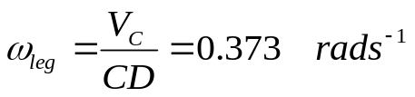
Kinematics of an undercarriage
E
θ = 30
1. Fixed points: D, A, E.
A
2. Absolute velocities on c and b lines (┴ to DC and AB respectively)
D
θ
B
c line
3. Jack velocity known in direction and magnitude
C
4, Projection on jack velocity on b line will identify point b
c
b
6. Velocity point C identified. In scale:
V_{C} = 22.4 cm/s
5. ┴ to BC from point b will provide velocity (V_{B})_{C} and intersection with c line
a,d,e
Notes:
AENG11301 - Aeronautics and Mechanics

Slide 6
Elevator control circuit - example
Fore and aft motion of the control column is transferred to a set of torque tubes running the length of the fuselage. At the rear, a crank connected to the tube operates the elevator through a simple linkage. If the torque tubes are of steel (G = 85 e9 Pa) with outside diameter 0.08 m and effective overall length 7.5 m, calculate the thickness of the tube required to limit the angular distortion of the system to 0.3°, if the moment applied to the crank is 40 Nm.
Torque tube details:
G = 85 GPa
d₀=0.08 m
l = 7.5 m
M_{max} = 40 N m
θ_{max} = 0.3º
Find:
thickness t under these conditions
Notes:
AENG11301 - Aeronautics and Mechanics

Slide 7
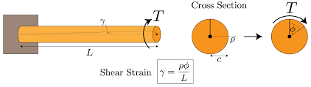
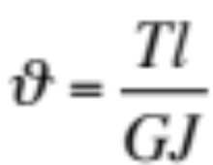
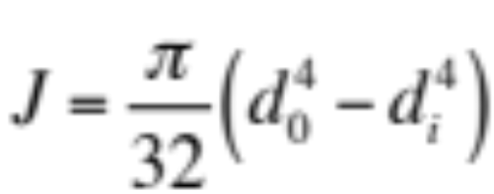
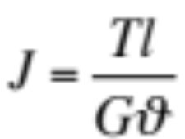
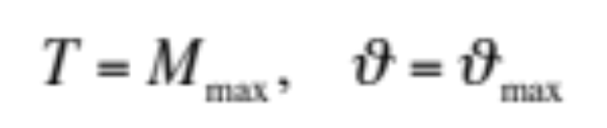
Elevator control circuit - example
Distortion of a beam loaded in torsion:
(a)
(b)
Polar moment of inertia
From (a) →
(c)
For maximum load and distortion →
Substituting in (c) → T = 6.741 X 10⁻⁷ m⁴
Important: convert degrees in radians!
Notes:
AENG11301 - Aeronautics and Mechanics

Slide 8
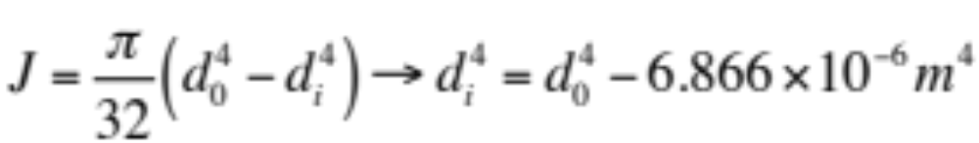
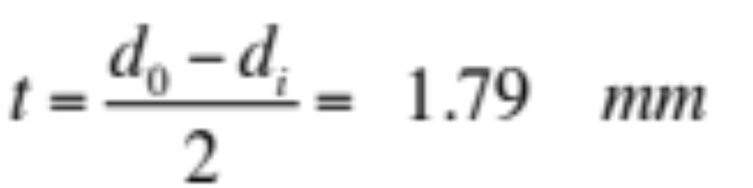
Elevator control circuit - example
From (b):
We obtain:
d_{i} = 0.076 m
Notes:
AENG11301 - Aeronautics and Mechanics

Slide 9
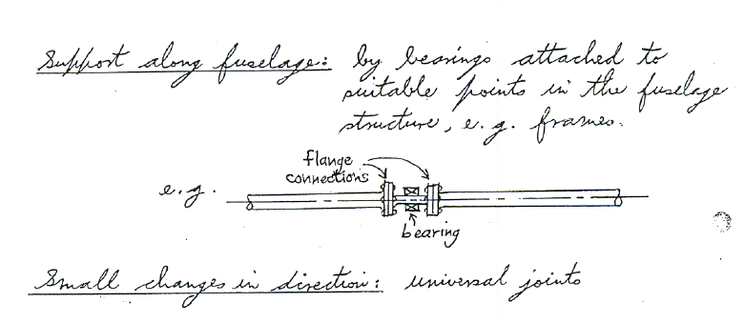
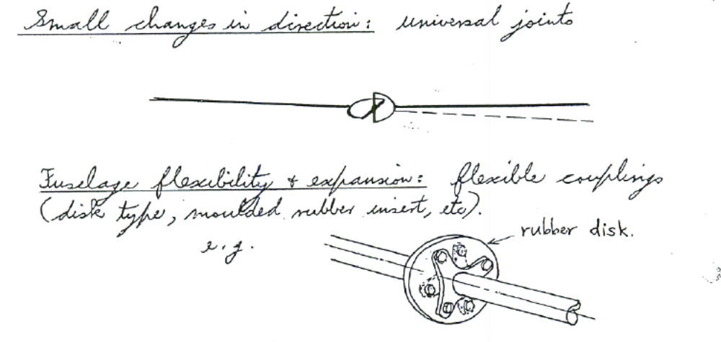
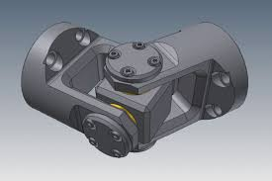
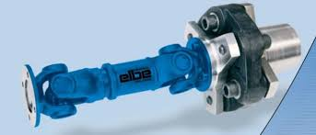
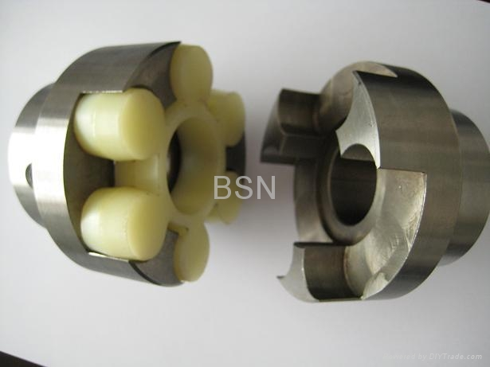
Elevator control circuit - example
Support along the fuselage: by using bearings attached to suitable points, e.g. frames
Small changes in direction: use universal joints
Fuselage flexibility + expansion: use flexible couplings (disk type, moulded rubber insert, etc)
Notes:
AENG11301 - Aeronautics and Mechanics

Slide 10
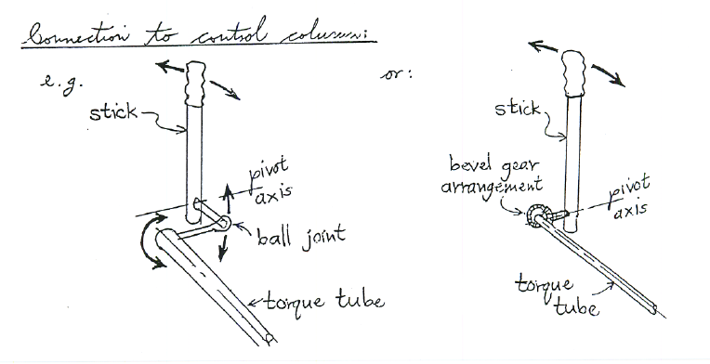
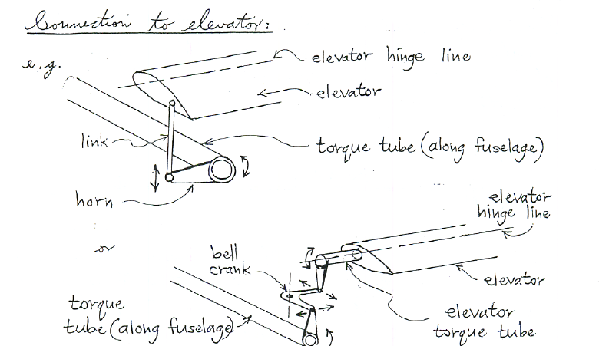
Elevator control circuit - example
Connection to control system:
Connection to elevator:
Notes:
AENG11301 - Aeronautics and Mechanics

Slide 11
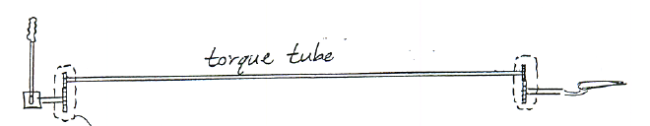
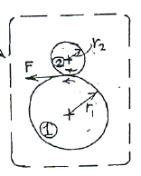
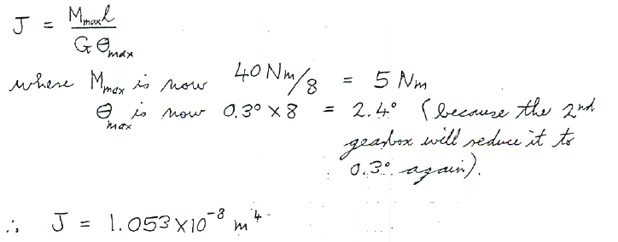
Elevator control circuit - example
Gearboxes are now added to increase the rate of rotation of the tubes by a factor of 8 to the control column and the elevator actuating crank. Calculate the reduction in diameter, or thickness, or both, that is possible for the same overall angular distortion and for the same moment applied to the crank.
Notes:
AENG11301 - Aeronautics and Mechanics

Slide 12
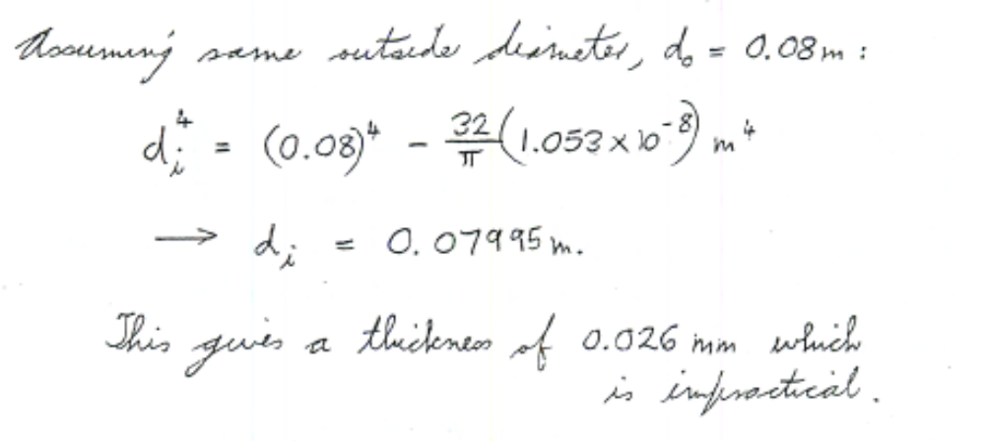
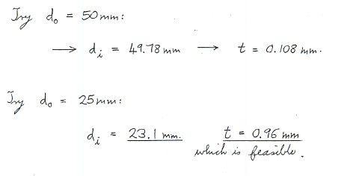
Elevator control circuit - example
Assuming same outer diametre:
This gives a thickness of 0.026 mm, which is impractical.
Try
Try
Which is feasible
Notes:
AENG11301 - Aeronautics and Mechanics

Slide 13
Example of gear train
D
25
26
A fixed, X driving at 50 rpm CW
C
X
75
74
A
B
A
X
C+D
B
1. Rotate whole locked CW
1
1
1
1
2.Fix X, rotate A of 1 CCW
-1
0
75/25 = 3
-(26/74) X 3
3. 1 + 2 → A fixed, X rotated of 1
0
1
4
1-(78/74)=-4/74
For X @ 50 rpm, multiply 3. by 50
Notes:
AENG11301 - Aeronautics and Mechanics

Slide 14





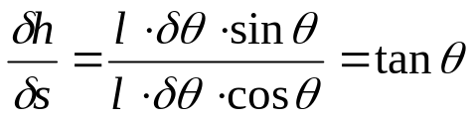
Note on PVW
Example: car jack.
Load is applied by screw thread across horizontal diagonal. If the load on the jack is W, find the tension in the screw
D
Ans. Application of PVW. Only θ is DOF
l
W
l
Work done by forces T:
T
A
B
Work done by W:
l
θ
l
C
Alternatively:
l δθ
δs virtual displacement of A and B
δs will induce upward displacement δh
l δθ
A
δθ
θ
l
VW at points A and B: 2 T δs
VW at points C : - W δh
Notes:
AENG11301 - Aeronautics and Mechanics

